Slide 1
SemEval2019 Task3

Slide 2
Dataset
Train: 30160 samples
Dev: 2755 samples
id | turn1 | turn2 | turn3 | label
0 | Don't worry I'm girl | hmm how do I know if you are | What's ur name? | others
1 | When did I? | saw many times i think -_- | No. I never saw you | angry
2 | By | by Google Chrome | Where you live | others
13 | Bad | Bad bad! That's the bad kind of bad. | I have no gf | sad
28 | You are very funny | so I've been told | India | happy
Label | # of Samples
Happy | 4243
Angry | 5506
Sad | 5463
Others | 14948
id | turn1 | turn2 | turn3
0 | Then dont ask me | YOURE A GUY NOT AS IF YOU WOULD UNDERSTAND | IM NOT A GUY FUCK OFF
1 | Mixed things such as?? | the things you do. | Have you seen minions??
2 | Today I'm very happy | and I'm happy for you ❤ | I will be marry
3 | Woah bring me some | left it there oops | Brb

Slide 3
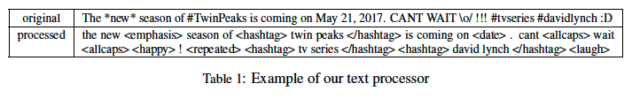
Preprocess
Utilize the ekphrasis2 (Baziotis et al., 2017) tool as a tweet preprocessor
http://github.com/cbaziotis/ekphrasis
The preprocessing steps included in ekphrasis are
Twitter-specific tokenization
spell correction
word normalization (e.g. #TwinPeaks → <hashtag> )
word segmentation (for splitting hashtags)
word annotation

Slide 4
Embedding
word2vec-GoogleNews-vectors
pre-trained Google News corpus word vector model
Corpus size: 3 billion running words
Vocab size: 3 million
Dimension: 300
https://drive.google.com/file/d/0B7XkCwpI5KDYNlNUTTlSS21pQmM/edit
NTUA
pre-trained twitter word vector model
Corpus preprocessed by: Ekphrasis
Corpus size: 550M
Dimension: 300
Vocab size: 804870
Word2vec training parameters: window_size = 6, negative_sampling = 5, min_count = 20
https://drive.google.com/file/d/1b-w7xf0d4zFmVoe9kipBHUwfoefFvU2t/view

Slide 5
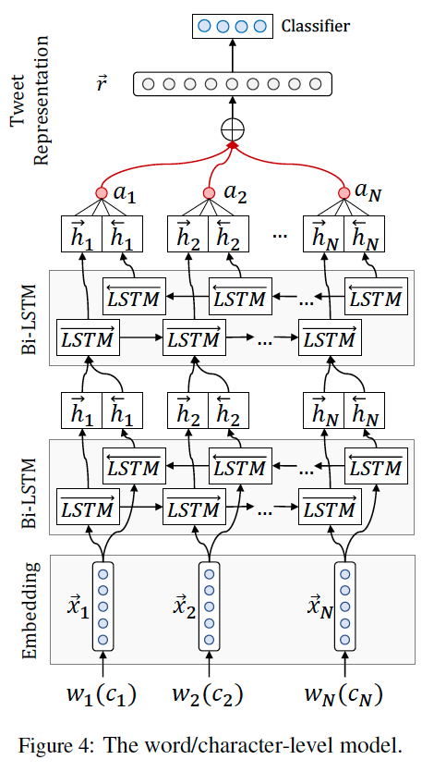
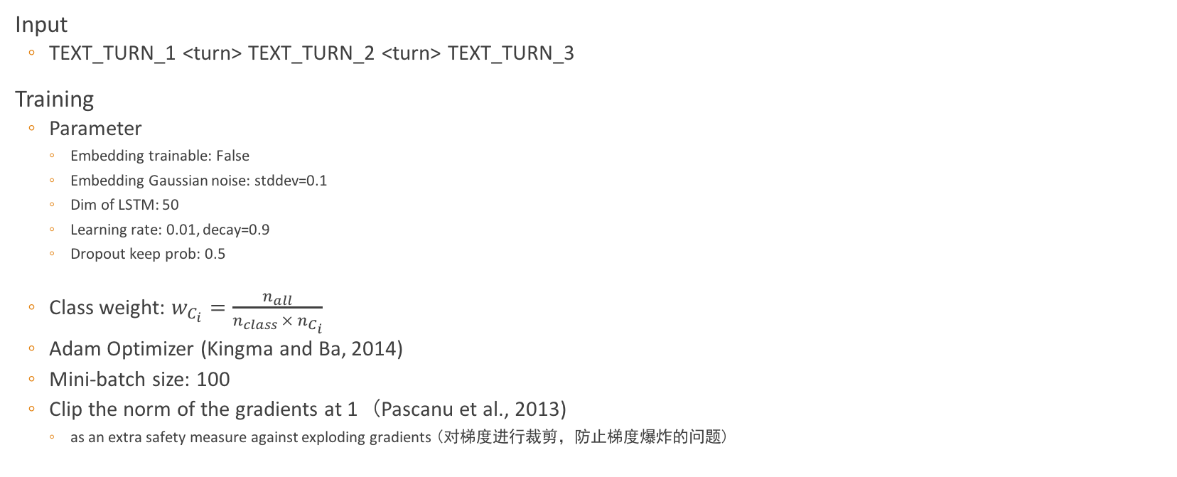
Model
Input
TEXT_TURN_1 <turn> TEXT_TURN_2 <turn> TEXT_TURN_3
Training
Parameter
Embedding trainable: False
Embedding Gaussian noise: stddev=0.1
Dim of LSTM: 50
Learning rate: 0.01, decay=0.9
Dropout keep prob: 0.5
Class weight: $w_{C_{i}}=\frac{n_{all}}{n_{class} × n_{C_{i}}}$
Adam Optimizer (Kingma and Ba, 2014)
Mini-batch size: 100
Clip the norm of the gradients at 1 (Pascanu et al., 2013)
as an extra safety measure against exploding gradients (对梯度进行裁剪，防止梯度爆炸的问题)

Slide 6
Evaluation
Data distribution
Training data consists of about 5k samples each from 'angry', 'sad', 'happy' class, and 15k samples from 'others' class
Both Dev and Test sets have a real life distribution, which is about 4% each of 'angry', 'sad', 'happy' class and the rest is 'others' class
Metric
Micro-averaged F1-score for the three emotion classes i.e. Happy, Sad and Angry
Pµ = ΣTPi / Σ(TPi + FPi)∀i {Happy,Sad,Angry}
Rµ = ΣTPi / Σ(TPi + FNi)∀i {Happy,Sad,Angry}
TPi is the number of samples of class i which are correctly predicted
FNi and FPi are the counts of Type-I and Type-II errors respectively for the samples of class i.
ﬁnal metric F1µ will be calculated as the harmonic mean of Pµ and Rµ.

Slide 7
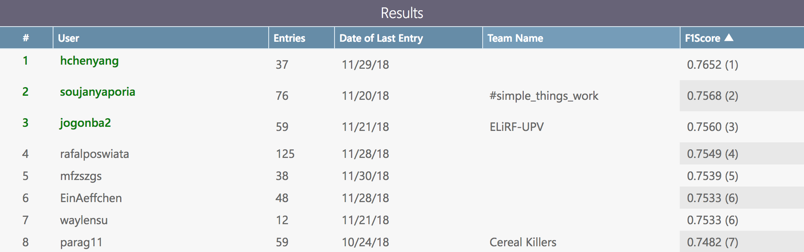
Results

Slide 8
Slang Distribution
 | Google |  | NTUA
 | train | dev | train | dev
# of token out of vocab | 3048 | 381 | 993 | 85
 |  | Google |  | NTUA
 |  | Train samples with token out of vocab
 | # of training samples | number | percent | number | percent
others | 14948 | 2099 | 14.04% | 555 | 3.71%
happy | 4243 | 601 | 14.16% | 120 | 2.83%
sad | 5463 | 540 | 9.88% | 121 | 2.21%
angry | 5506 | 628 | 11.41% | 155 | 2.82%

Slide 9
Analysis of Confusion Matrix
ntua_ek_1543580873
Train
accuracy | 0.9214
precision | 0.9442
recall | 0.8863
f1 | 0.9143
 |  | Pred
 |  | others | happy | sad | angry | # of samples | (percent)
Gold | others | 13426 | 252 | 63 | 213 | 13954 | 46.89%
 | happy | 98 | 3955 | 6 | 5 | 4064 | 13.66%
 | sad | 425 | 12 | 5268 | 148 | 5853 | 19.67%
 | angry | 599 | 24 | 126 | 5140 | 5889 | 19.79%
 |  | 14548 | 4243 | 5463 | 5506 | 29760
 | Precision | 92.29% | 93.21% | 96.43% | 93.35%
Dev
accuracy | 0.8733
precision | 0.8417
recall | 0.5417
f1 | 0.6592
 |  | Pred
 |  | others | happy | sad | angry | # of samples | (percent) | has_to_others | Recall
Gold | others | 2055 | 32 | 13 | 7 | 2107 | 76.48% |  | 97.53%
 | happy | 75 | 108 | 2 | 0 | 185 | 6.72% | 40.54% | 58.38%
 | sad | 65 | 1 | 104 | 4 | 174 | 6.32% | 37.36% | 59.77%
 | angry | 143 | 1 | 6 | 139 | 289 | 10.49% | 49.48% | 48.10%
 |  | 2338 | 142 | 125 | 150 | 2755
 | Precision | 87.90% | 76.06% | 83.20% | 92.67%

Slide 10
Label
Dense
Feature of A
Feature of B
Attention
Attention
RNN
RNN
RNN
RNN
RNN
RNN
Turn A1
Turn B
Turn A2

Slide 11
w1
RNN
Attention
Feature of A
w2
RNN
Dense
w1
Label
RNN
Attention
w2
RNN
RNN
w1
RNN
w2
RNN
Feature of B

